Slide 1

Agenda
Pega Scenario Testing
Scenario testing in Dev Studio
Scenario testing in User portal
Pega Unit Testing

Slide 2
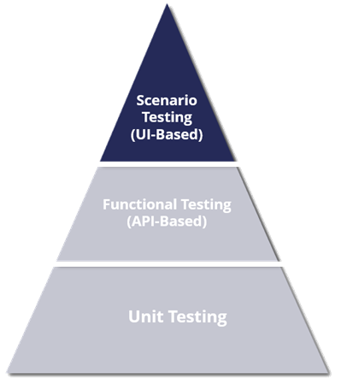
Ideal Test Pyramid
Industry best practices for test automation
Testing shown at the bottom of pyramid are least expensive
Easiest to maintain, take the least amount of time to run, and usually represent the greatest number of tests in the test suite
Test types at the top of the pyramid, such as scenario testing, are the most expensive to run, hardest to maintain, take the most time to run, and should represent the least number of tests in the test suite
The higher up the pyramid , the higher the overall cost and the lower the benefits
Ideal Test Pyramid

Slide 3
Test in Dev Studio Vs User portal
In Dev Studio, you can view test cases, run test cases individually or in a batch, edit test case steps and configure steps to setup and clean-up test data of a test case. You cannot create new test cases and modify the flow of a test case from this landing page.
In a user portal, you can create new test cases, run test cases individually, edit test case steps, and modify the flow of a test case. You cannot run test cases in a batch and configure actions to set up and clean up test data for a test case.

Slide 4
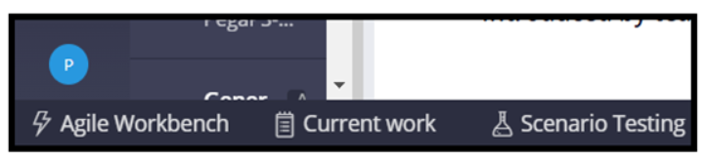
Scenario tests in Dev Studio (1)
On the Application: Scenario testing landing page, you can view and run scenario test cases. The Application: Scenario testing landing page is accessible from the Configure menu in the header of Dev Studio. You can also access the landing page by clicking Scenario Testing in the footer of Dev Studio, as shown in the following image:

Slide 5
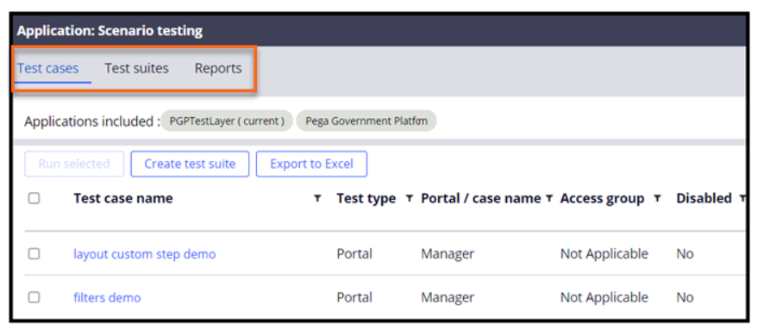
Scenario tests in Dev Studio (Continued)
The Application: Scenario testing landing page consists of three tabs in which you manage respective artifacts:
Test cases: On this tab, you can view and run all Pega scenario test cases that are authored for your Pega application. You can also filter test cases based on test type, case type or portal name, access group, and other fields.
Test suites: On this tab, you can view all the test suites that for their Pega application. You can also filter test suites based on test suite name, test suite ID, and other fields.
Reports: On this tab, you can view test execution summary of your Pega scenario test cases. This tab also provides the test execution summary of the case and portal test types.

Slide 6
Pega unit test
In a Pega Platform application, the smallest unit is an individual rule. The purpose of unit testing a Pega Platform application is to verify the functional behavior of the application rules at a unit level. When compared with the unit testing tools available in the market that work on testing the source code, Pega unit testing involves working with individual rules and not the source code, thus making it an easy to use tool for users.
For example, you ensure that a data page or a decision table works as expected in isolation. It is much easier and faster to test the various permutations and outputs of these rules through unit testing than other forms of testing.
Automated unit testing of a Pega Platform application involves the following actions:
Creating unit-test cases for each rule.
Logically grouping multiple test cases into test suites.
Running tests regularly.
Verifying results and taking corrective actions.

Slide 7
Components of a Pega unit rule form
The Pega unit rule form consists of the following tabs:
Definition: This tab displays the following information about the Pega unit test along with parameters:
Label
Description
Class
Rule (This tab also provides users with the ability to configure validations for the test. )
Setup & Cleanup: This tab gives the steps that are configured to set up and clean up the test data.
Pages & Classes: This tab displays temporary pages -used for testing,displays the classes to which the pages belong.
History: This tab displays the revision history.

Slide 8
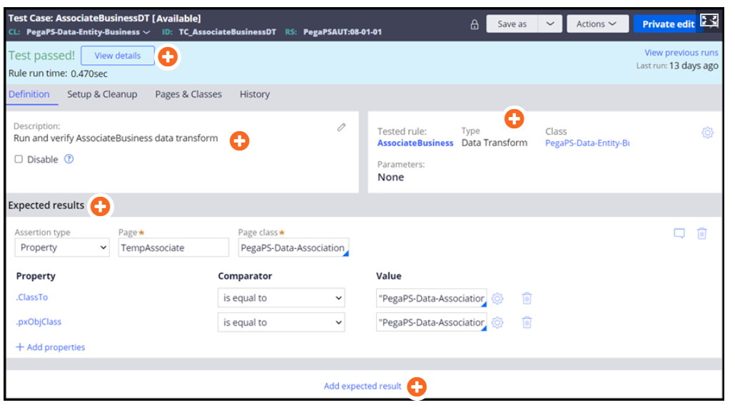
Components of a Pega unit rule form (Continued)
Various components of the Definition tab on the Pega unit rule form:

Slide 9
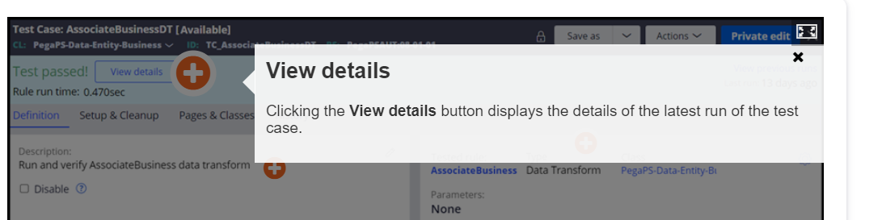
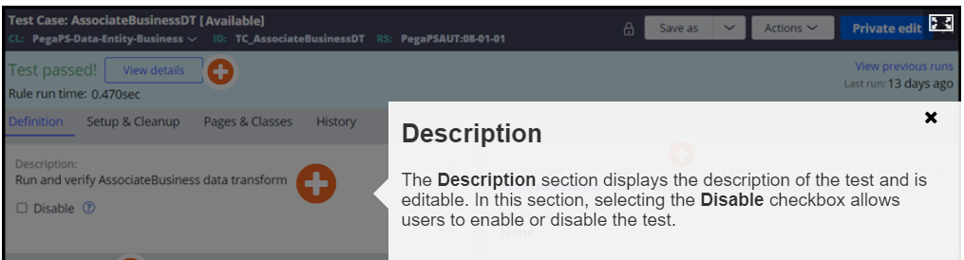
Components of a Pega unit rule form (Continued)
Various components of the Definition tab on the Pega unit rule form:

Slide 10
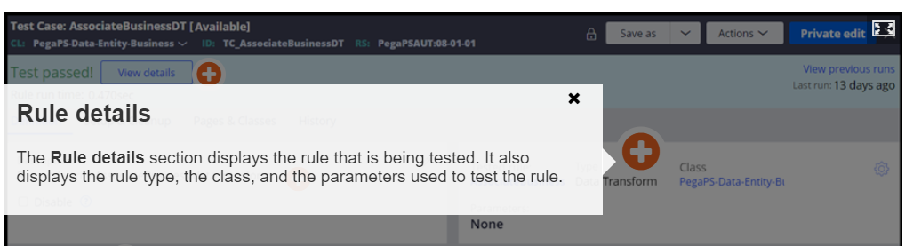
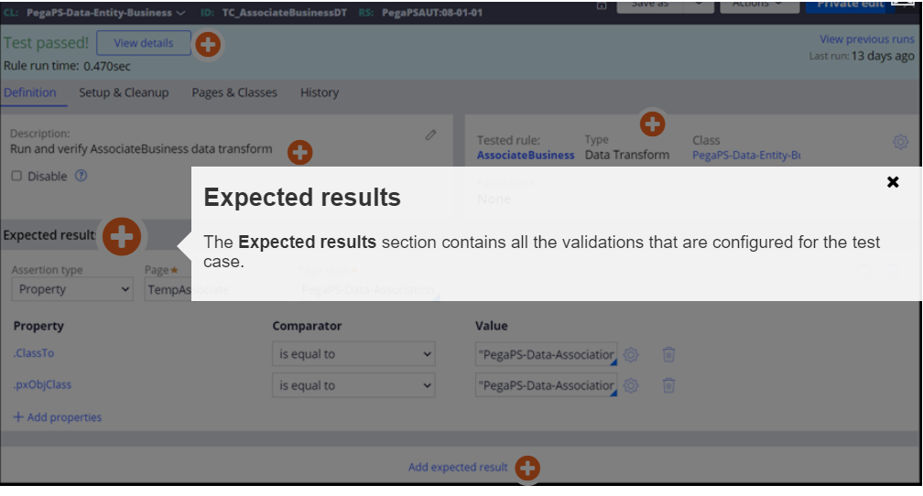
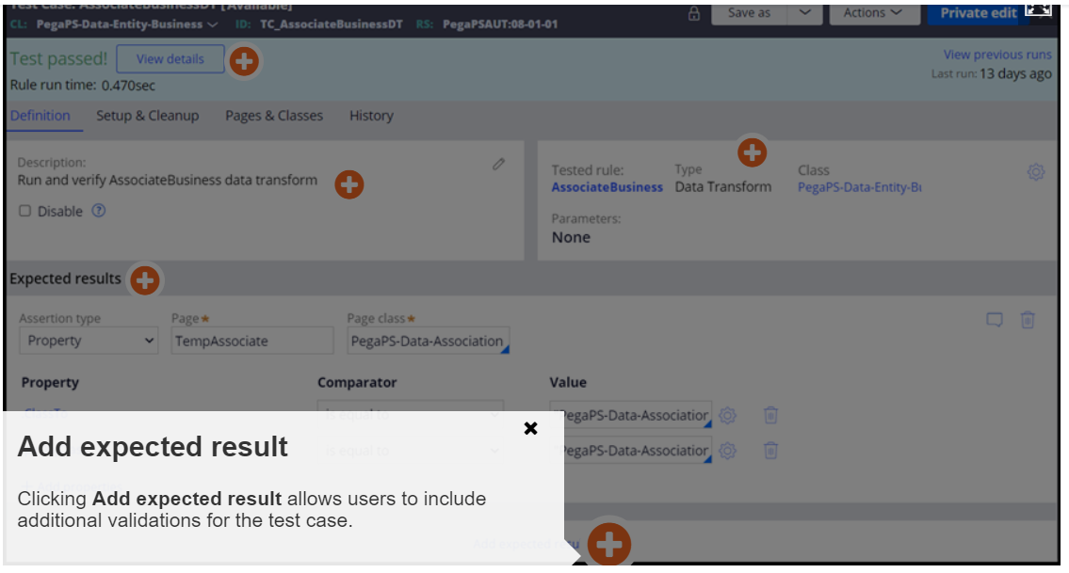
Components of a Pega unit rule form (Continued)
Ruleset configuration to save test cases
To save Pega unit test cases, users enable the Use this ruleset

Slide 11
User interface-based functional and scenario tests
Use UI-based functional tests and end-to-end scenario tests to verify that end-to-end cases work as expected
The UI-based scenario testing tool allows developers to focus on creating functional and useful tests for single-page applications (SPAs) rather than writing complex code.
You can provide data to your test cases with a predefined data page. The data page provides unique values for each execution of the test case. You can populate the data page using any source, including activities or data transforms.
Tests are saved in a dedicated test ruleset defined in the application rule
Once saved, tests are available on the Application: Scenario testing landing page
Navigate to the landing page from the header of Dev Studio by selecting Configure > Application > Quality > Automated Testing > Scenario Testing> Test Cases.
From the landing page, you can run a test, view the results of a previous test, and group functionally similar tests in test suites to provide organization.

Slide 12
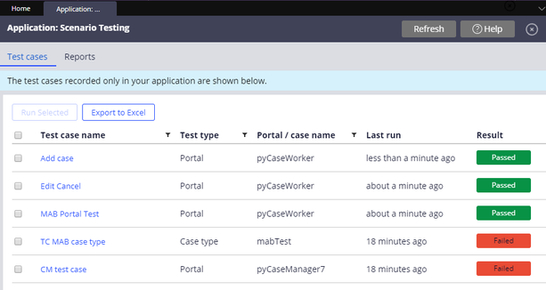
Create UI-based tests with automated scenario testing
Scenario tests are run against a user interface to verify that the end-to-end scenarios are functioning correctly. The UI-based scenario testing tool allows developers to focus on creating functional and useful tests, rather than writing complex code, for single page applications (SPAs).
You can test either a specific case type or an entire portal by clicking Scenario Testing in the run-time toolbar to open the test recorder. When you use the test recorder and hover over a testable element, an orange highlight indicates that the element can be tested. Interactions are recorded in a visual series of steps and the execution of a test step can include a delay.
Provide data to your test cases with a predefined data page. This data page can provide unique values for each execution of the test case. You can populate the data page by using any source, including activities or data transforms.
Tests are saved in a test rule set. After they are saved, tests are available on the Application: Scenario Testing landing page. From the landing page you can run a test or view the results of a previous test run.

Slide 13
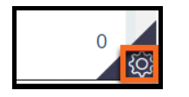

Pega Scenario Testing in User Portal
In a user portal, the Pega scenario testing framework has the Scenario tests pane in which you can view and manage scenario test cases for your Pega application.
The following sequence opens the Scenario tests pane in a User portal:
The Toggle runtime toolbar in the lower-right corner of the User portal opens the runtime toolbar.
The Toggle Automation Recorder on the runtime toolbar opens the Scenario tests pane

Slide 14
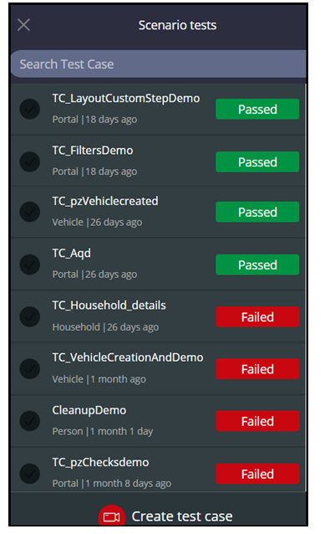
Pega Scenario Testing in User Portal(Cont..)
The following figure shows the Scenario tests pane with examples of test cases that either passed or failed:

Slide 15
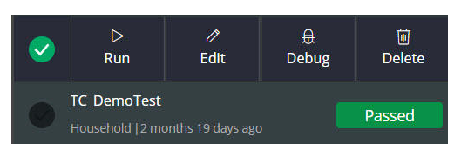
Pega Scenario Testing in User Portal(Cont..)
In this pane, you can access all the scenario test cases for case types and interaction portals of an application. Use the Search Test Case field to search for test cases.
You can create a new scenario test case in a User portal only. In the Scenario tests pane, users click Create test case to create a test case. You can also view, edit, debug, run, and delete scenario test cases in the Scenario tests pane. When you select a test case, the Run, Edit, Debug, and Delete options are displayed, as shown in the following figure:

Slide 16
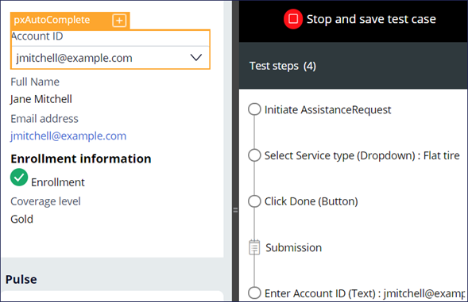
View on Test cases

Slide 17
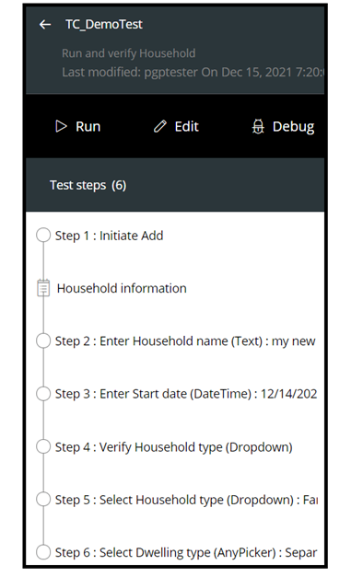
Pega Scenario Testing in User Portal(Cont..)
To view a recorded test case, click the name of the test case. The recorded steps of that test case are displayed. You can run, edit, and debug the opened test case, as shown in the following figure:

Slide 18

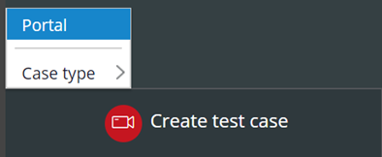
Scenario testing feature on Pega Platform
Scenario tests are captured in the context of the application portal only, such as the User Portal or a similar application portal. You use the Automation Recorder on the runtime toolbar to create or modify a scenario test.
You can test either a specific case type or an entire portal.
An orange highlight indicates any supported user interface element that can be tested when you use the test recorder and hover over a testable element. Interactions are recorded in a visual series of steps, and the execution of a test step can include a delay.

Slide 19
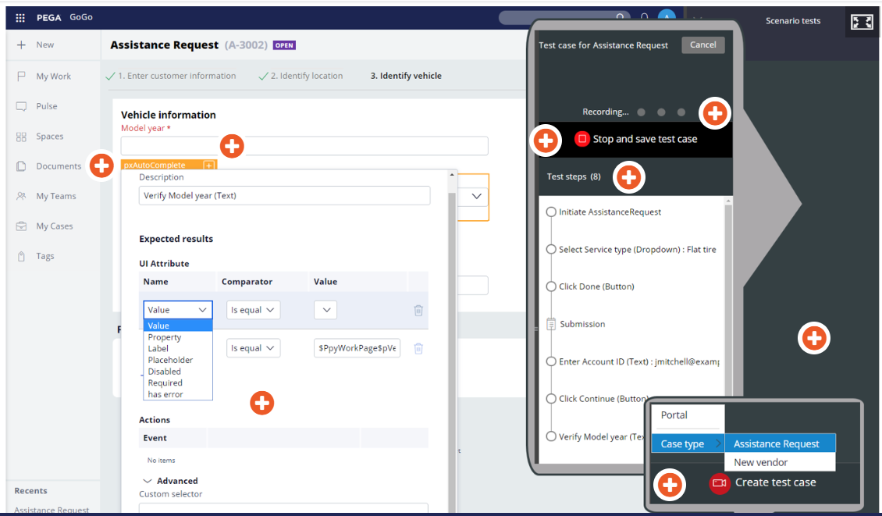
Automation Recording

Slide 20
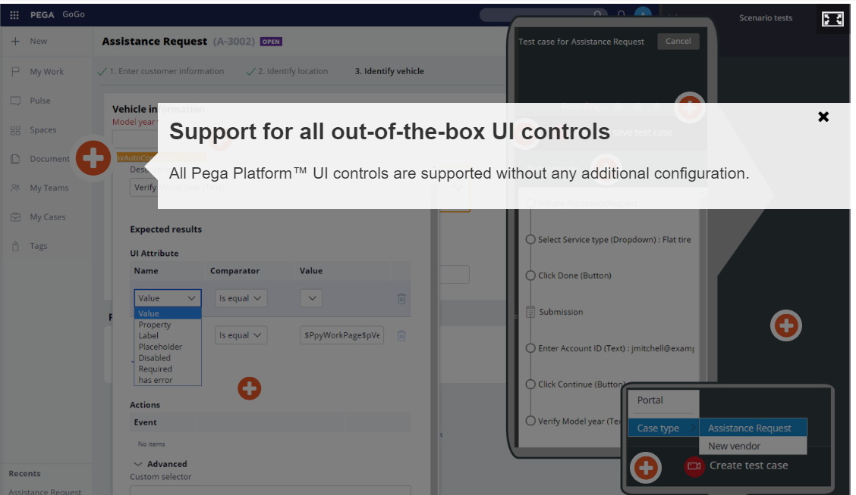
Automation Recording- sections

Slide 21
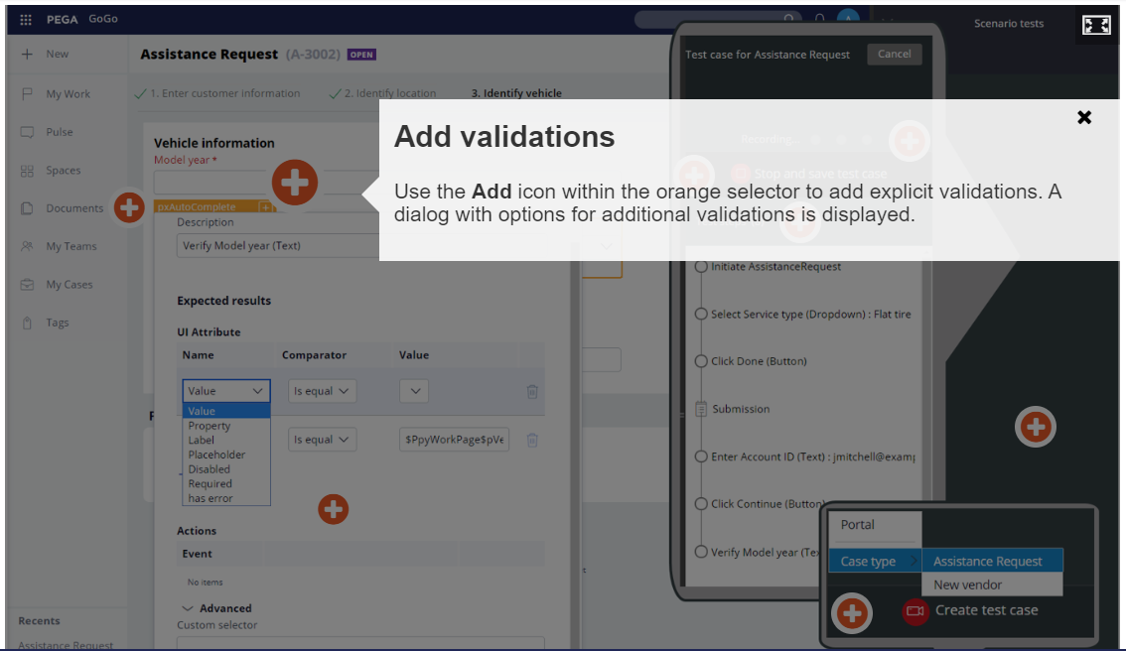
Automation Recording- sections

Slide 22
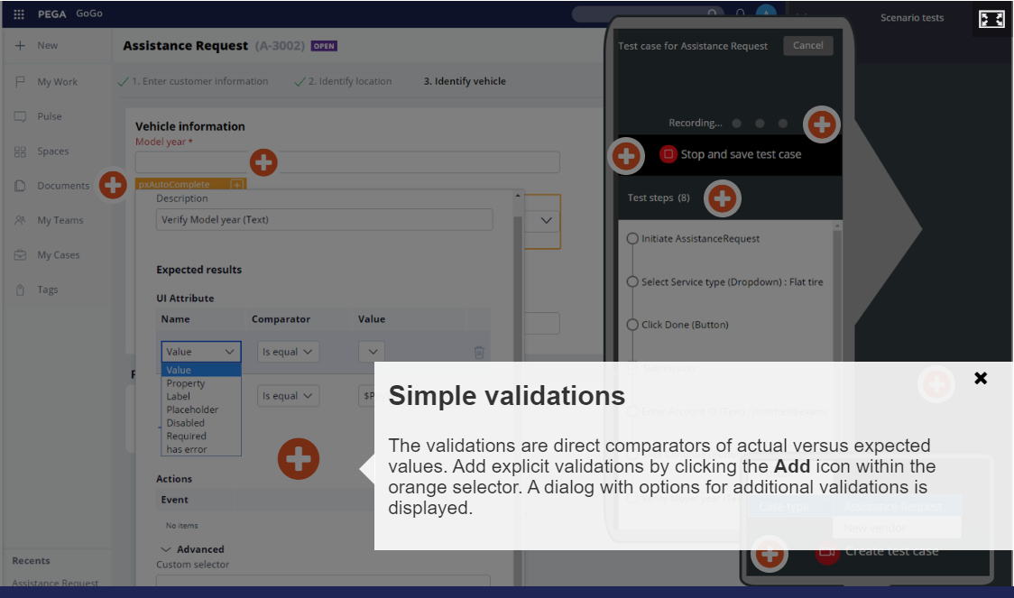
Automation Recording- sections

Slide 23
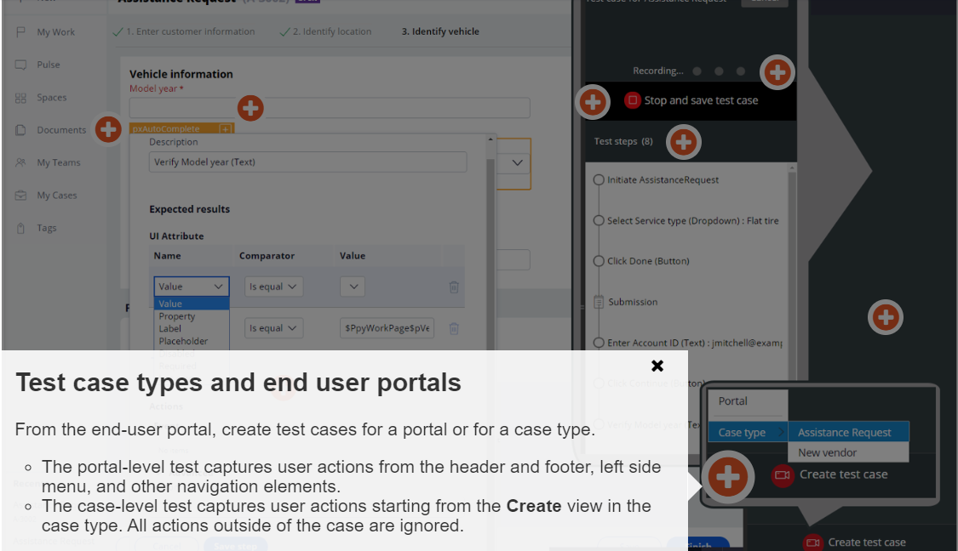
Automation Recording- sections

Slide 24
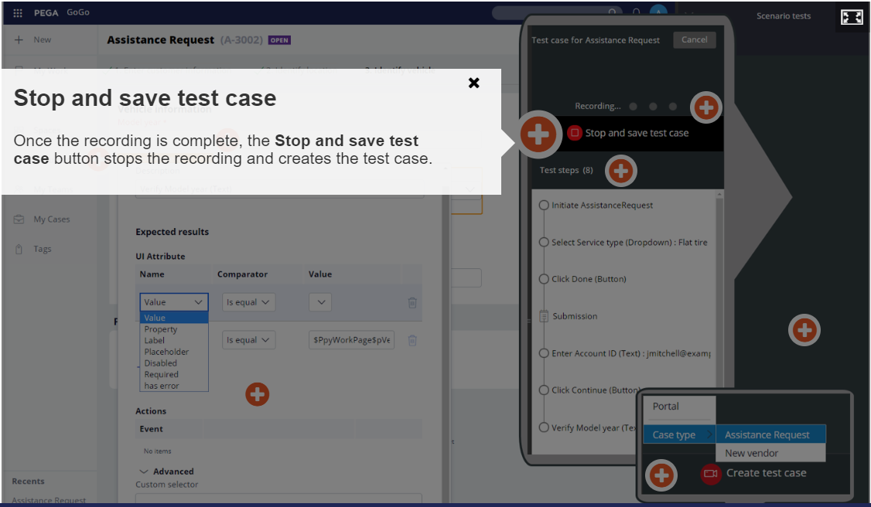
Automation Recording- sections

Slide 25
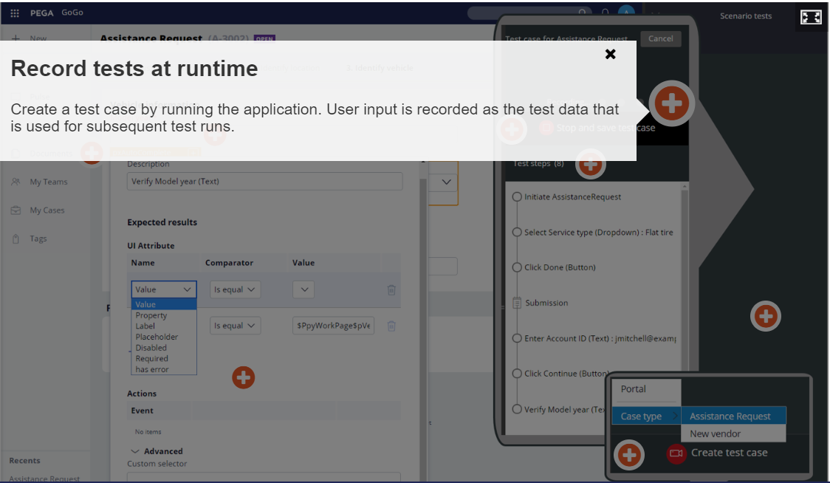
Automation Recording- sections

Slide 26
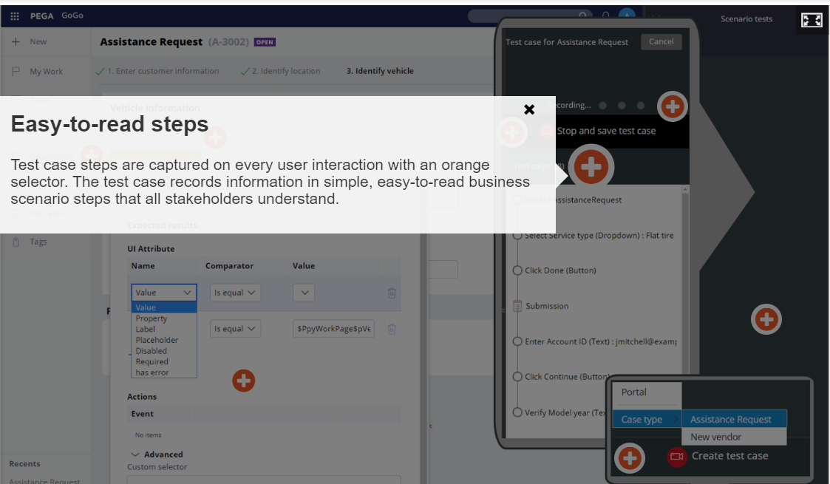
Automation Recording- sections

Slide 27
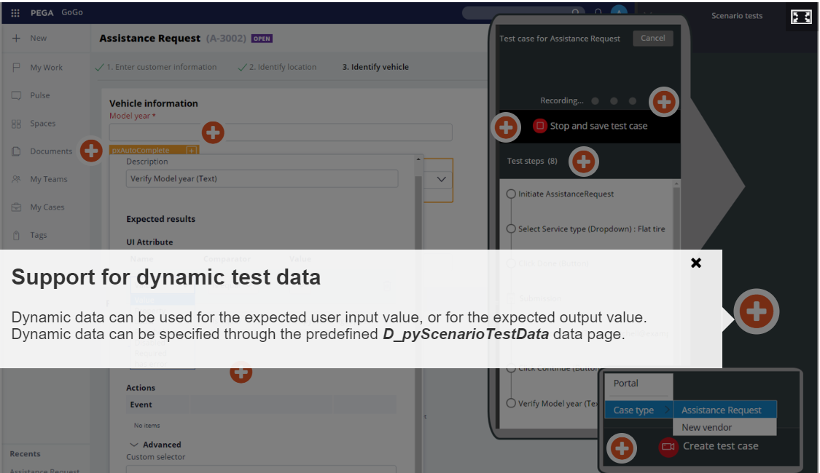
Automation Recording- sections

Slide 28
Creating scenario tests
Launch the portal in which you want to do the test.
Do one of the following to open the automation recorder:
In App Studio, on the lower-left side of the screen, click the Test icon.
In Dev Studio, on the lower-right side of the screen, toggle the run-time toolbar, and then click the Toggle Automation Recorder icon.
In the Scenario tests pane, click Create test case, and then select the test type:
To record a test for a portal, select Portal.
To record a test for a case, select Case type, and then select the type of case for which you want to record the test.
Record the steps for the test by clicking the user interface elements.
Optional : To add an explicit assertion to the test, do the following tasks:
Hover over an element.
Click the Mark for assertion icon on the orange highlight box.
In the Expected results section, click Add assertion.
Define the assertion by completing the Name, Comparator, and Value fields.
Click Save step.
***

Slide 29
***
To delay the execution of a step, do the following tasks. You can delay the execution of a step to add latency to a web browser and actions on a web page to prevent tests from failing when there is complex processing or slow UI rendering.
Click the Mark for assertion icon on the orange highlight box.
In the Wait field, enter the number of milliseconds by which to delay the execution of the step.
Click Save step.
When you finish adding steps, in the Test case pane, click Stop and save test case.
On the New test case form, save the test:
Enter a name and a description for the test.
In the Context section, select a branch or ruleset in which you want to save the test.
In the Apply to field, enter the name of a class that is relevant to the test.
Click Save.

Slide 30
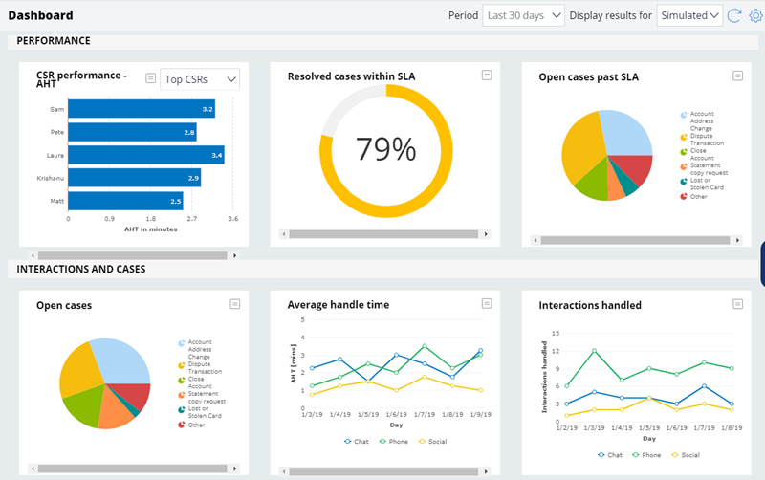
Reports
The Reports tab displays the test types, total number of tests, and the number of tests passed, failed, or not run. From the Reports tab, you can also export the test results to an Excel spreadsheet.

Slide 31
References
https://academy.pega.com/topic/scenario-testing/v1
https://docs-previous.pega.com/whats-new-pega-platform/create-ui-based-tests-automated-scenario-testing

Slide 32
THANK YOU
THANK YOU

